Slide 1
Tampines Regional Library
LearnX Community
Pi Python Introductory Course
Course Material
By
Goh Soon Seng
PLEASE DO NOT WRITE ANYTHING ON THE PAGES OF THIS BOOKLET. THANK YOU.

Slide 2

If you can type, you can code!!
COURSE OBJECTIVE
Learn the basics of Python Programming
Foster a spirit of tinkering and making
WE ENCOURAGE
Continuous life-long learning
Self directed learning
OUR TEACHING PLATFORM
The Raspberry Pi Pico W
The Thonny IDE.

Slide 3
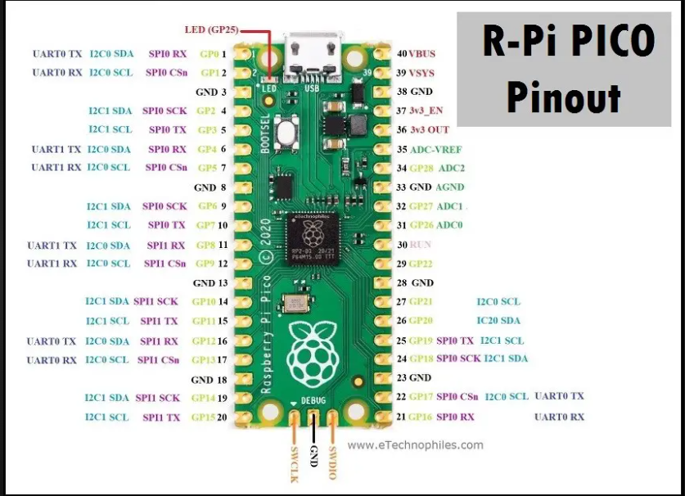

Slide 4
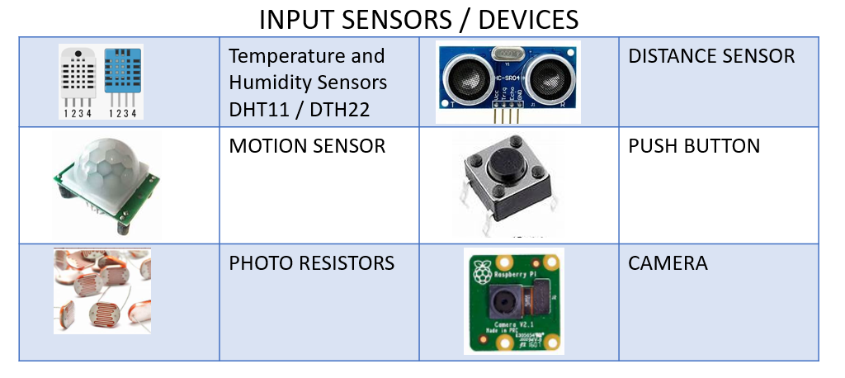
Input devices

Slide 5
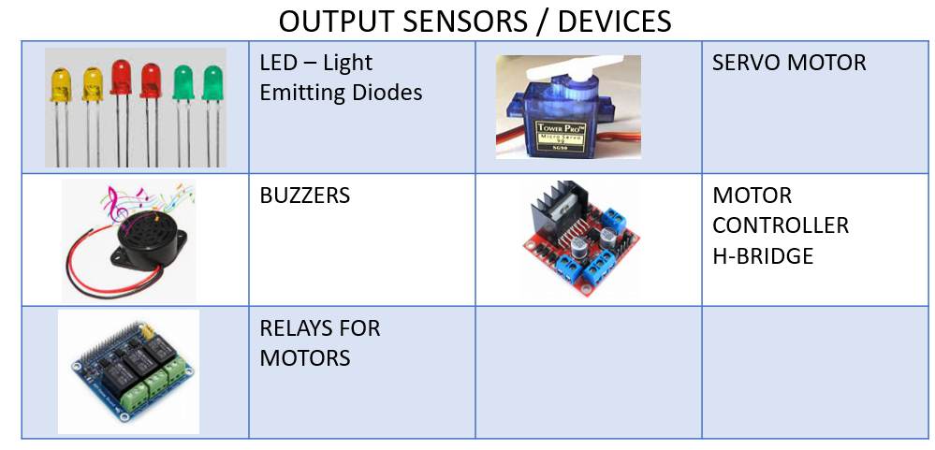
Output devices

Slide 6
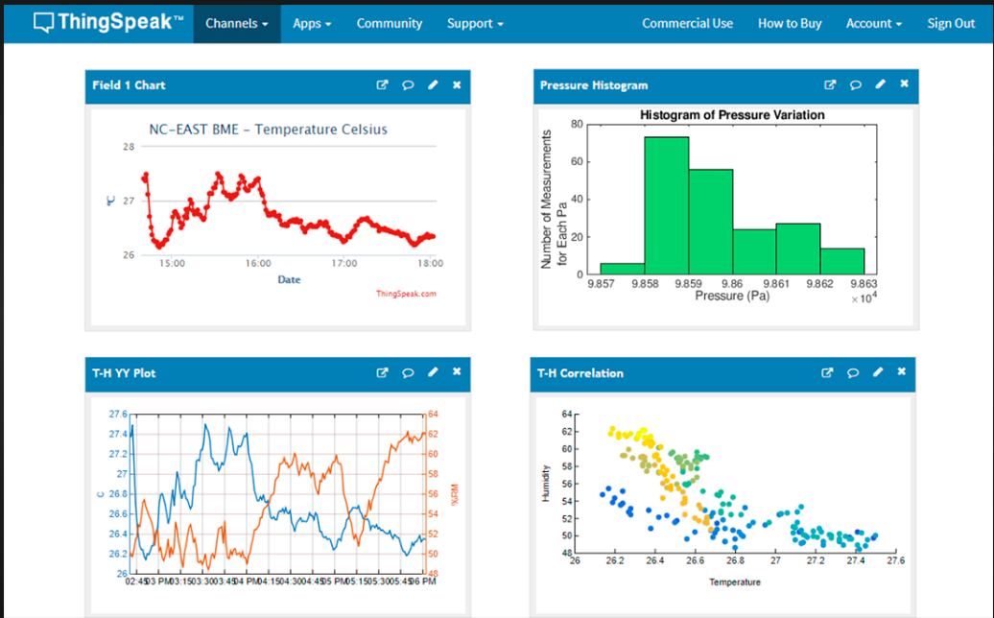
Data collection & visualisation

Slide 7
Programme
Python Lesson – Session # 1
LIBRARIES
machine
time
tm1637
picozero
VARIABLES
LOOPS
while True:
PYTHON RULE
Indentation
Character casing
Python Lesson – Session # 3
MORE PYTHON CODING
PASSWORD
Python Lesson – Session # 2
FUNCTIONS
CONDITIONAL STATEMENTS
if else
LOOPS
while True:
for
MESSAGING
how humans and machine communicate with each other
Python Lesson – Session # 4
REVISION & TEST
programming the lights and siren of a patrol car
INTRODUCTION TO CHATGPT
How to login to ChatGPT
Getting ChatGPT to help us code
Learning using ChatGPT

Slide 8
Python Lesson – Session # 1
LIBRARIES
machine
Time
picozero
VARIABLES
LOOPS
while True:
PYTHON RULE
Indentation
Character casing

Slide 9
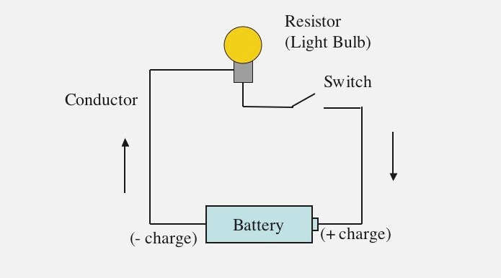
Introduction to Circuits
What is a circuit?
Notes:
You need three things for an electrical circuit
Energy source (battery)
Device that uses energy (LED bulb)
Conductor (wires)

Slide 10
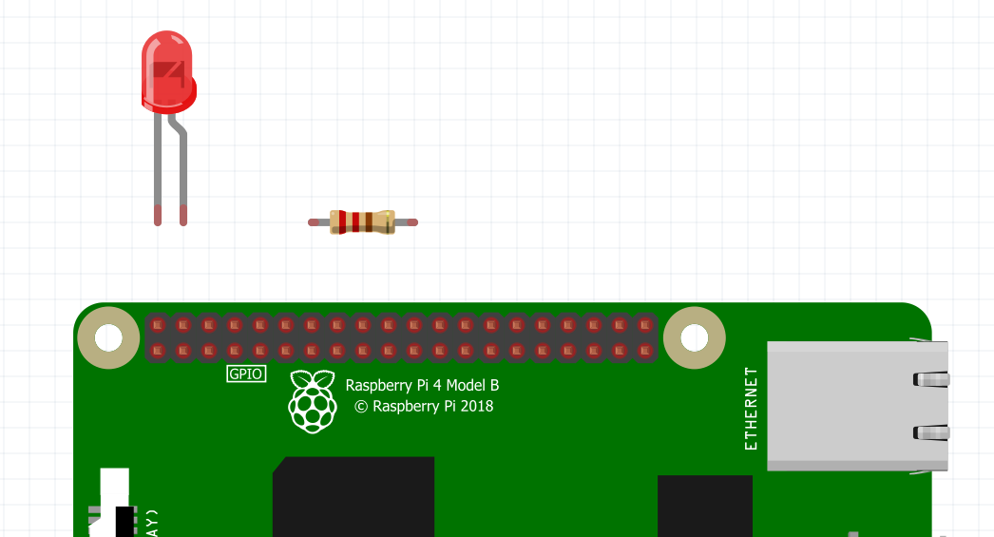
Instead of a manual switch
you will learn how to use Python codes to control the circuit

Slide 11
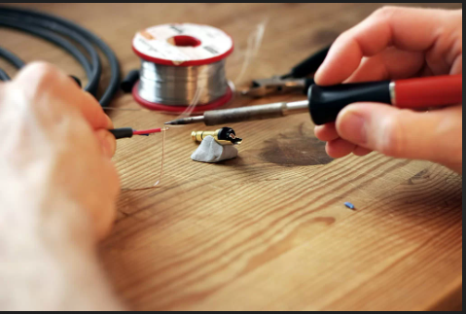
Wiring up a Circuit

Slide 12
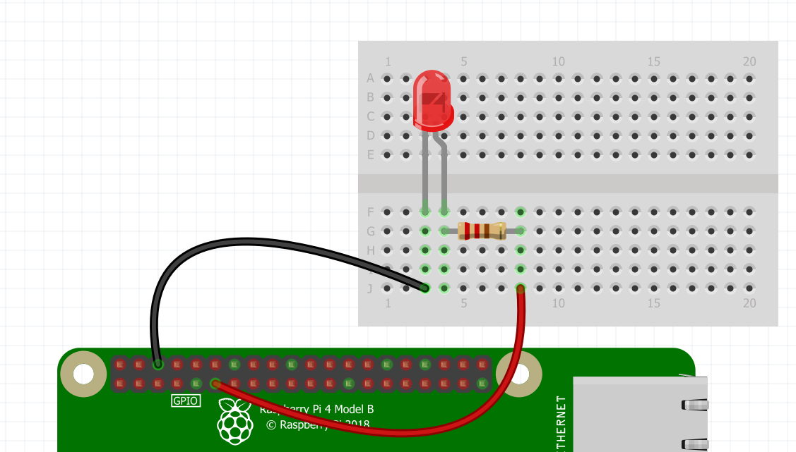
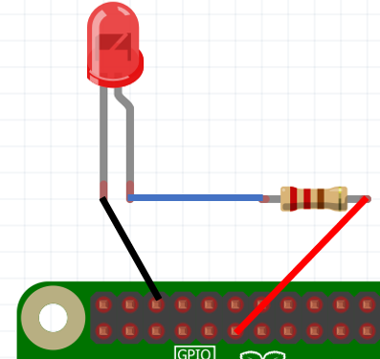
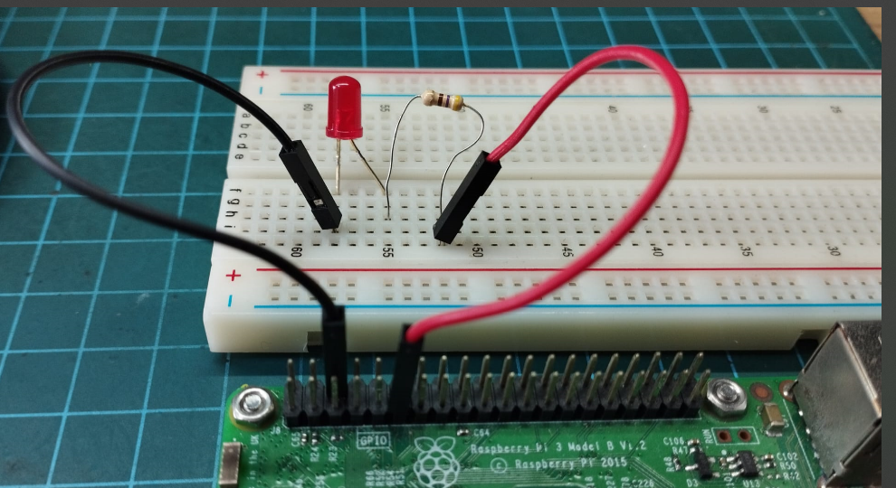
BREADBOARD

Slide 13
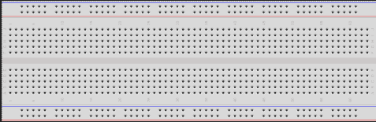
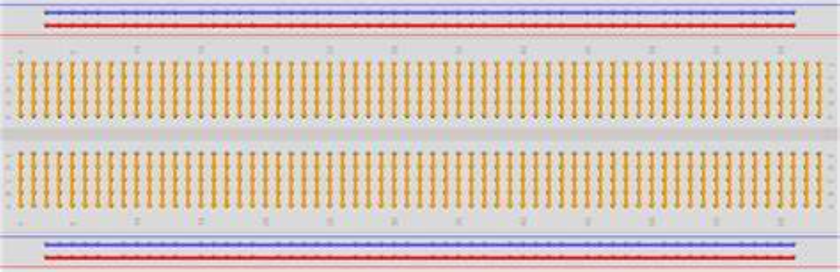
THE BREADBOARD
POWER RAIL
EXTERNAL
GROUND RAIL
INTERNAL
Connections inside the Breadboard

Slide 14
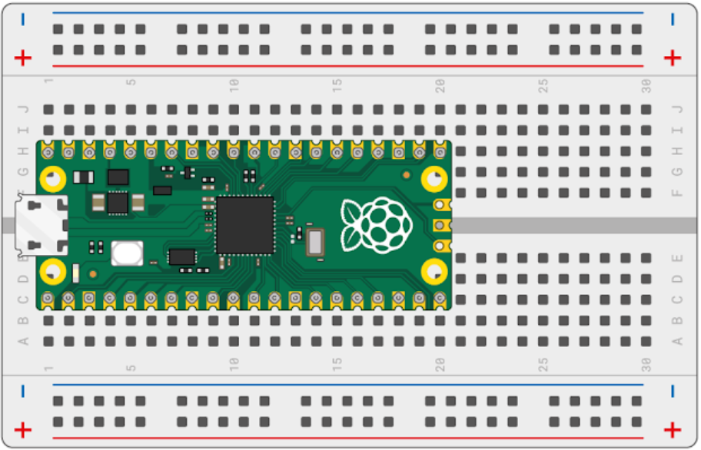
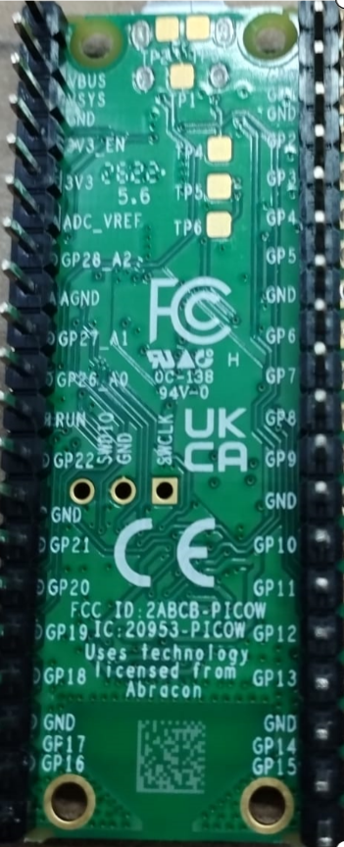
The Pico on a Breadboard

Slide 15
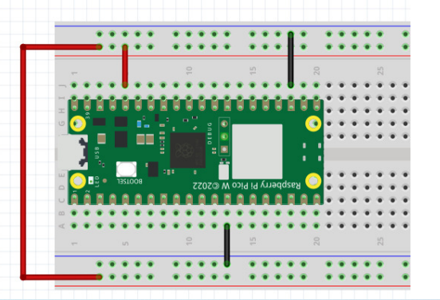
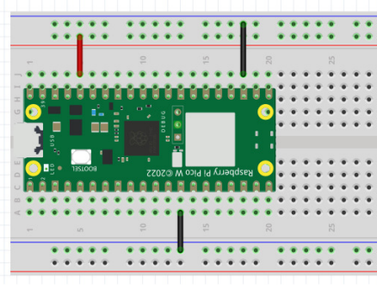
GROUND
GROUND
POWER
POWER
GROUND
GROUND
POWER
WE ARE USING THIS SETUP

Slide 16
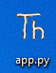
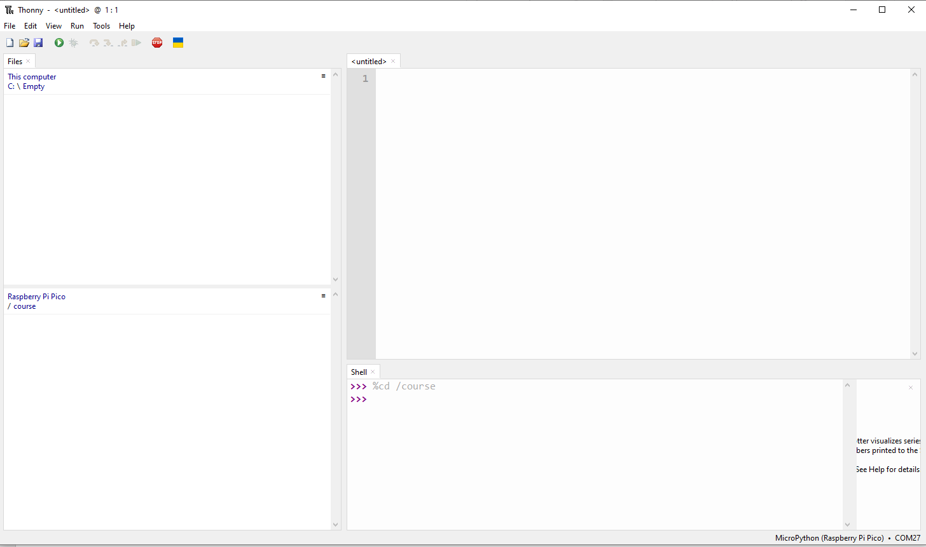
Connecting the Pico to the Laptop
1. Connect the USB Cable to the Pico
2. Connect the other end to the Laptop/PC
3. Look for this icon on the desktop or taskbar
4. Launch Thonny by double clicking / click the icon
5. Connect Thonny to the Pico

Slide 17
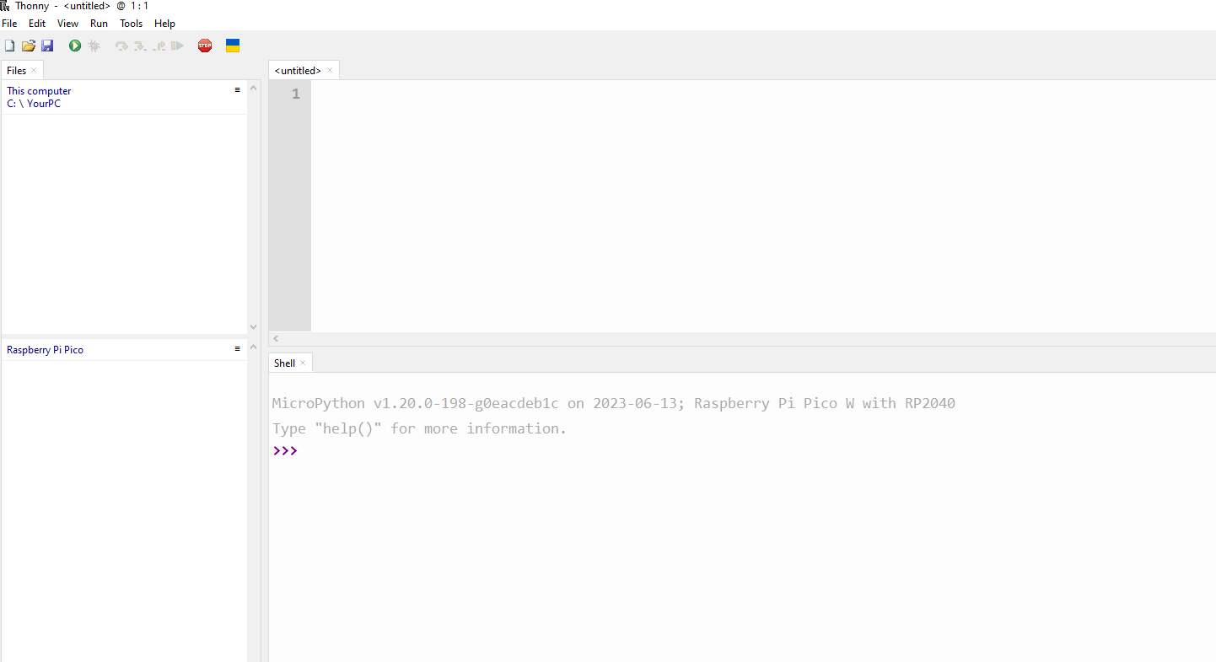
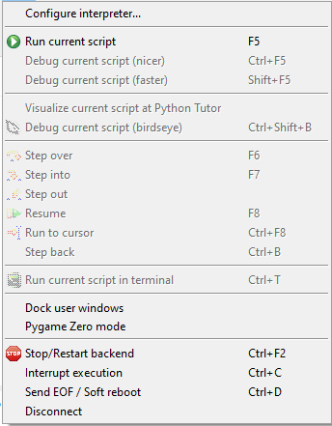
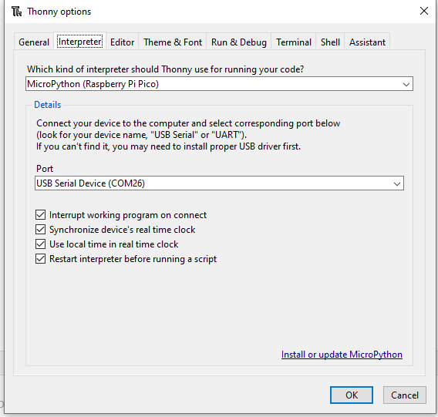
PC’s File Explorer
Program Editor
Pico’s File Explorer
Shell

Slide 18
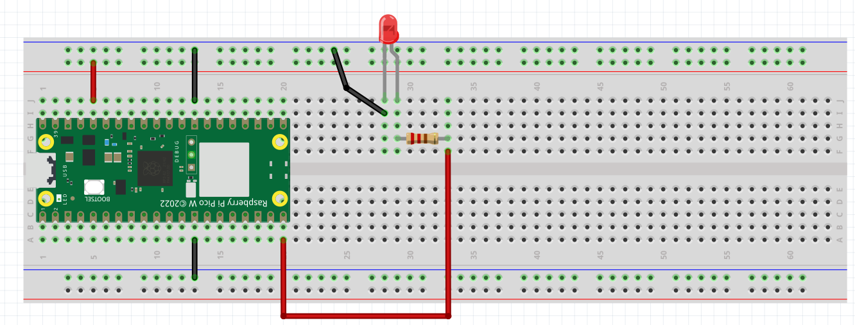
EXERCISE #1
Wiring a Light Emitting Diode (LED)
Please wire up the following circuit
LED
GROUND
_
3.3V
+
GROUND
200 OHM RESISTOR
GROUND
3.3V
PIN 15

Slide 19
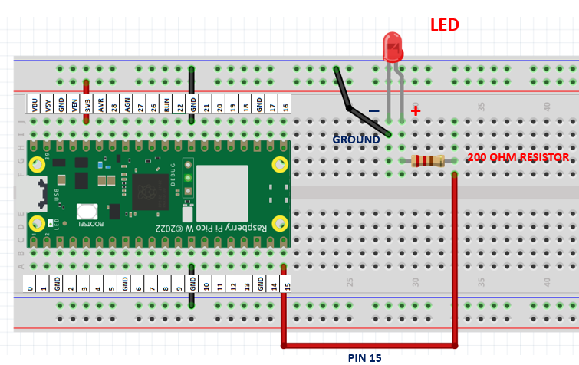

TESTING OUR CIRCUIT USING THONNY SHELL
Ex 1a. Turning our Red LED on
Library
>>> from picozero import LED
>>> red_led = LED(15)
Functionality
Variable
>>> red_led.on()
Ex 1b. Turning it off
>>> red_led.off()
Ex 1c. Blinking the red LED
Can you make it Blink too?

Slide 20
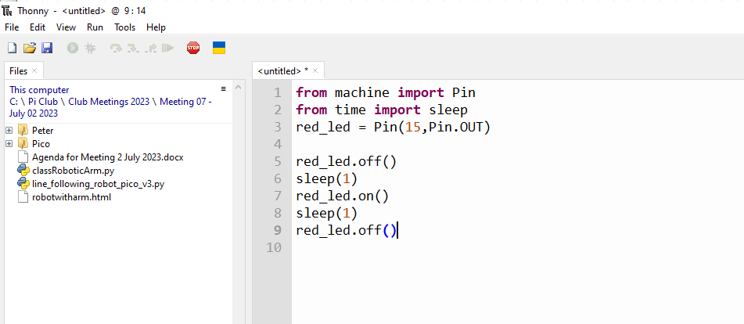
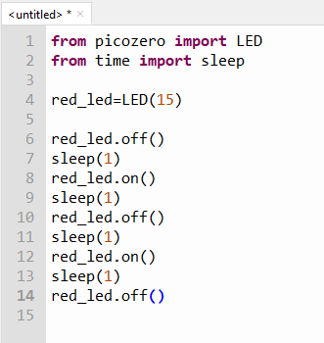
ALGORITHM TO CODE
Click here to start a new python program
Start with red led off
Wait 1 second
Turn red led on
Wait 1 second
Turn red led off
Wait 1 second
Turn red led on
Wait 1 second
Turn red led off
To run this python program
Editor
from time import sleep
CODE

Slide 21
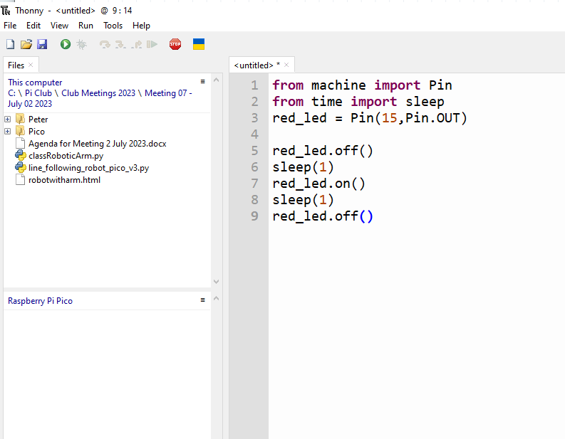
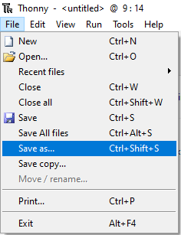
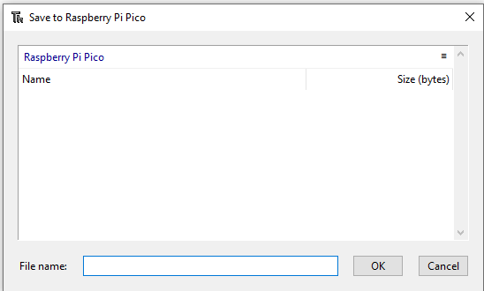
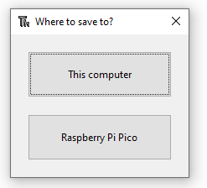
SAVE A PROGRAM
ex1c.py
ex1c.py

Slide 22
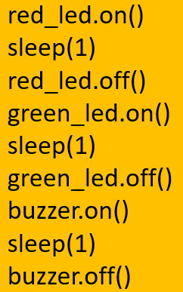
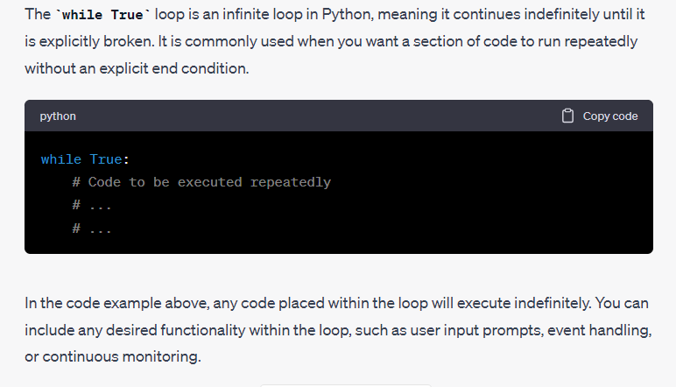
What if I want to blink my red LED forever?
while True: loop

Slide 23
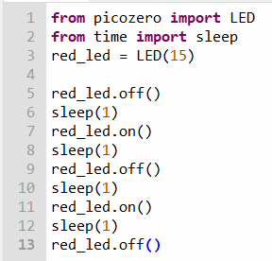
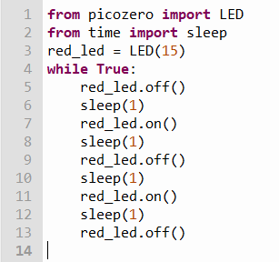
ex1c.py
Convert
indentation
Runs once
Runs forever
Run this new program
Save it as ex1d.py

Slide 24
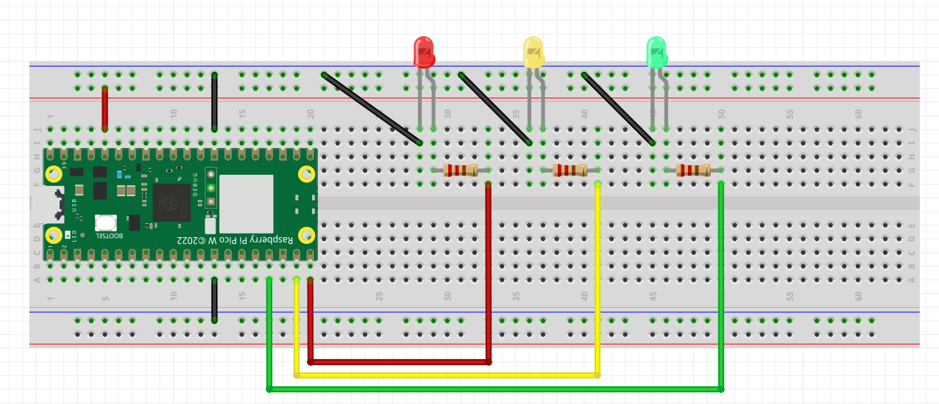
EXERCISE 2 – TRAFFIC LIGHT
Please wire up this new circuit
LED
GROUND
3.3V
GROUND
3.3V
PIN 15
PIN 14
PIN 13

Slide 25
EXERCISE 2 – CONTROLLING MULTIPLE LEDs
Ex 2a. Test the Circuit. Turn each of the LEDs ON and OFF
>>> from picozero import LED
>>> red_led= LED(15)
>>> yellow_led = LED(14)
>>> green_led=LED(13)
hint
Ex 2b. Turning the circuit into a Traffic Light System
Algorithm
Code
How does a traffic light work?
Green Light On
Give cars 10 seconds to cross
Green Light Off
Yellow Light On
Give 5 seconds warning
Yellow Light Off
Red Light On
Wait 10 seconds
Red Light Off
green_led.on()
sleep(10)
green_led.off()
yellow_led.on()
sleep(5)
yellow_led.off()
red_led.on()
sleep(10)
red_led.off()
How?
Code this in the editor
Run and save it as ex2b.py

Slide 26
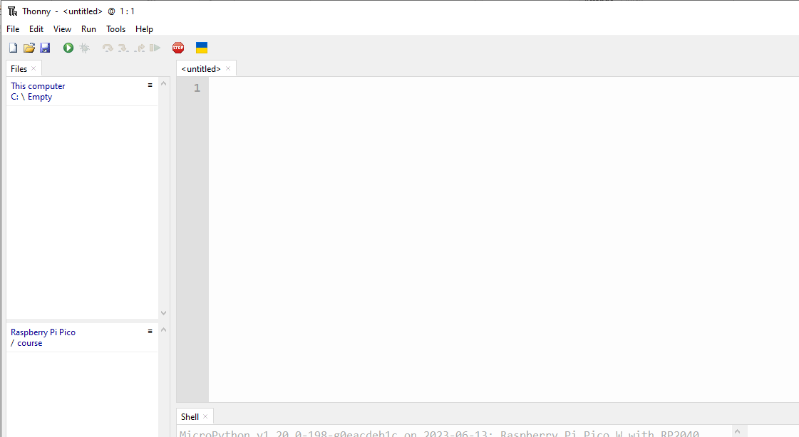
Lets create this program together
from picozero import LED
from time import sleep
red_led = LED(15)
yellow_led=LED( 14 )
green_led=LED( 13 )
green_led.on()
Run this program
Green Light On
Give cars 10 seconds to cross
Green Light Off
Yellow Light On
Give 5 seconds warning
Yellow Light Off
Red Light On
Wait 10 seconds
Red Light Off
sleep(10)
Save program as ex2c.py
green_led.off()
yellow_led.on()
sleep(5)
yellow_led.off()
red_led.on()
sleep(10)
red_led.off()

Slide 27
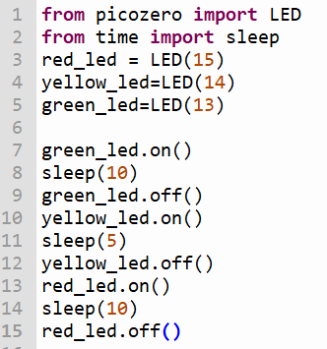
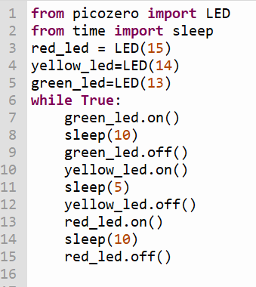
ex2c.py
convert
Runs forever
Runs once
Run the Program
Save it as ex2d.py

Slide 28
Python Lesson – Session # 2
FUNCTIONS
CONDITIONAL STATEMENTS
if else
LOOPS
while True:
for
MESSAGING
how humans and machine communicate with each other

Slide 29
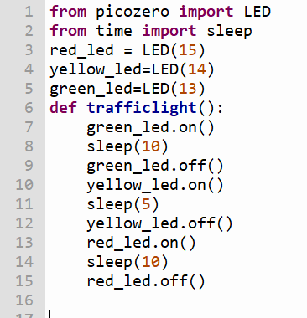
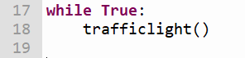
FUNCTION – A SET OF CODES WITH A NAME
ex2d.py
Run the Program
Save it as ex2e.py

Slide 30
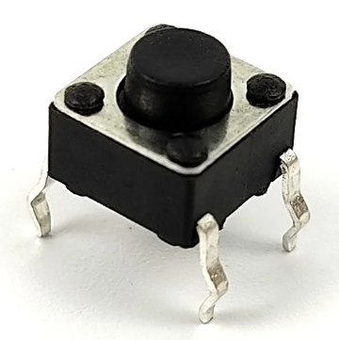
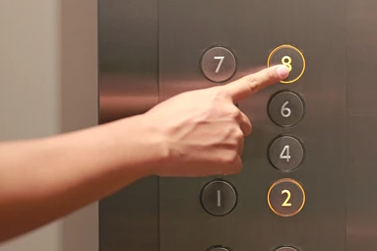
THE UBIQUITOUS BUTTON
THEY MOVE THE WORLD AROUND US
THEY WORK ROUND THE CLOCK
NOTHING GETS DONE WITHOUT THEM
THEY ARE OUR INTERMEDIARIES
WE PRESS THEM ALL THE TIME, YET THEY ARE PATIENT

Slide 31
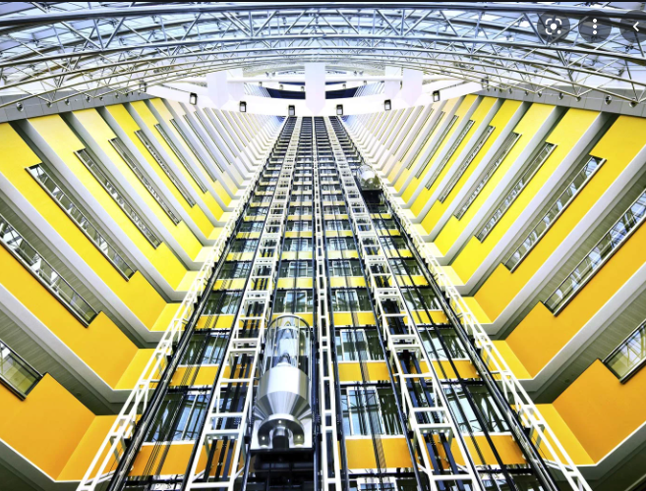


BUTTONS ARE EVERYWHERE IN THE REAL WORLD
HUMANS CANNOT DIRECTLY INTERACT WITH ELEVATOR SYSTEM
INTERACTION BETWEEN HUMANS AND THE REAL WORLD VIA A COMPUTER SYSTEM
ELEVATOR CONTROL SYSTEM
US HUMANS

Slide 32
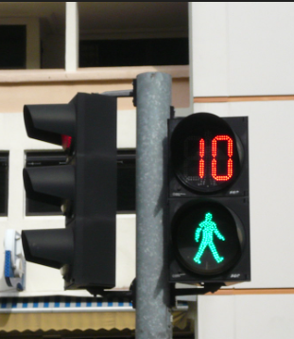
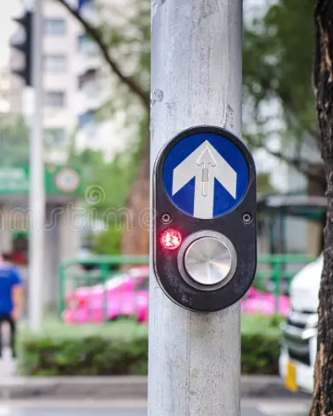
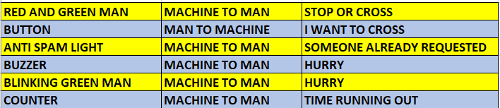
HOW DO HUMANS AND MACHINES COMMUNICATE IN THE REAL WORLD
WHAT DO YOU SEE AT A PEDESTRIAN CROSSING?
RED AND GREEN MAN
BUTTON
ANTI SPAM LIGHT
BUZZER
BLINKING GREEN MAN
COUNTER

Slide 33
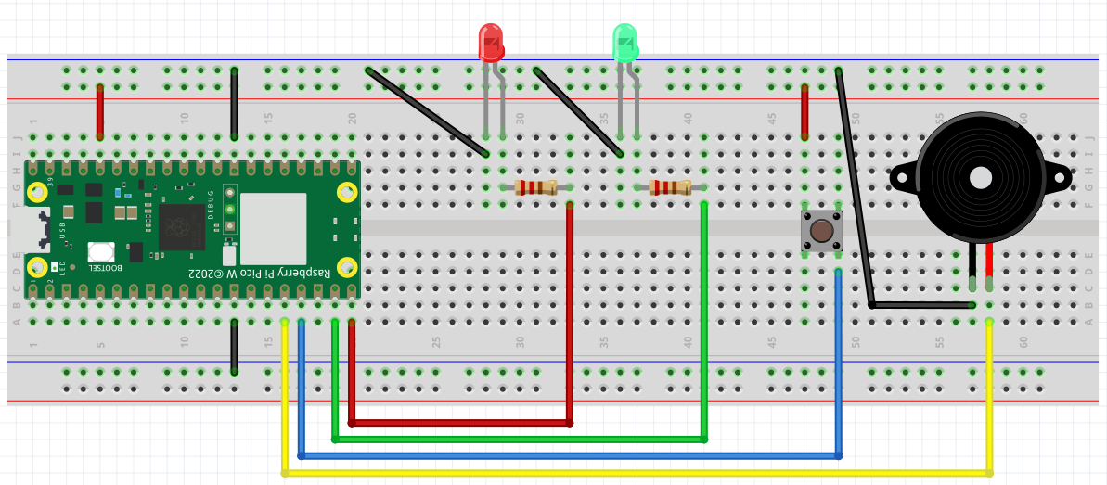
Exercise 3 – Wiring a Pedestrian Crossing
Look for + sign on the Buzzer
BUZZER
_
+
+
PIN 15
PIN 14
PIN 13
PIN 12

Slide 34
TESTING OUR CIRCUIT USING THONNY SHELL
Ex 3a. Turning our Buzzer on
>>> from picozero import Buzzer
>>> buzzer= Buzzer(12)
>>> buzzer.on()
Ex 3b. Turning it off
>>> buzzer.off()
Ex 3b. Setting up multiple sensors : our circuit has Buzzer, Button, LED
>>> from picozero import Buzzer, Button, LED
>>> buzzer= Buzzer(12)
>>> button=Button(13)
>>> red_led=LED(15)
Let’s say we want the LED
To light up when we press the button
And off when we release the button
>>> button.when_pressed = red_led.on
>>> button.when_released = red_led.off
>>> button.when_pressed = buzzer.on
>>> button.when_released = buzzer.off

Slide 35
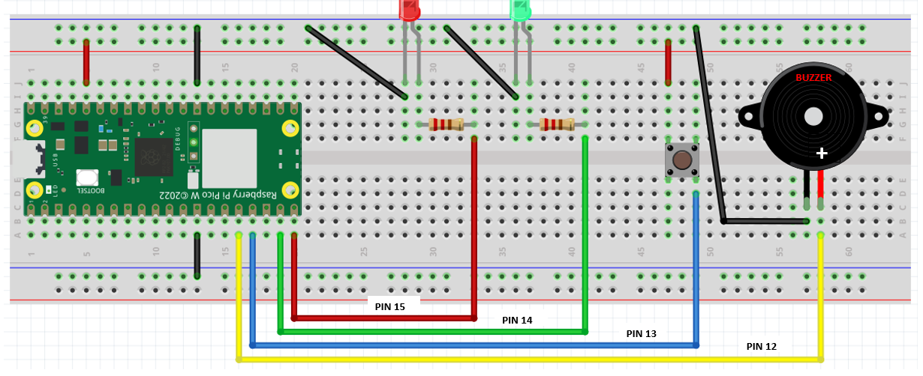
Exercise 3 – Turning the circuit into a pedestrian crossing with code
from picozero import LED, Buzzer, Button
from time import sleep
red_led = LED(15)
green_led=LED(14)
buzzer=Buzzer(12)
button=Button(13)
red_led.on()
green_led.off()
HOW DOES A PEDESTRAIN CROSSING WORK?
sleep(10)
red_led.off()
RED LED IS ON / GREEN LED IS OFF
WAIT FOR 10 SECONDS
RED LED GOES OFF
GREEN LED GOES ON
GIVE 10 SECONDS FOR PEOPLE TO CROSS
GREEN LED GOES OFF
RED LED TURNS ON
green_led.on()
convert
sleep(10)
green_led.off()
TO CODE
red_led.on()
RUN and
Save this program as ex3c.py

Slide 36
Exercise 3 – Turning the circuit into a pedestrian crossing with code
from picozero import LED, Buzzer, Button
from time import sleep
CONVERT THE
RUN ONCE PROGRAM
TO RUN FOREVER
RUN AND SAVE
PROGRAM AS
ex3a.py
red_led = LED(15)
green_led=LED(14)
buzzer=Buzzer(12)
button=Button(13)
red_led.on()
green_led.off()
sleep(10)
red_led.off()
green_led.on()
sleep(10)
green_led.off()
red_led.on()
RUN ONCE
convert
RUN FOREVER

Slide 37
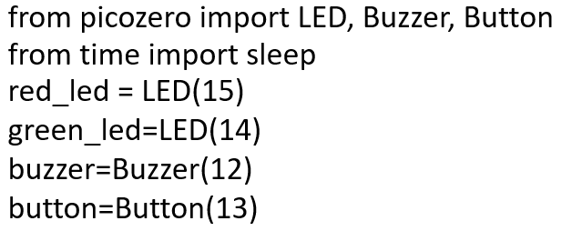
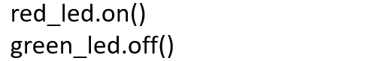
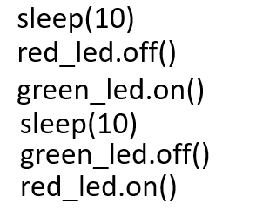
ex3d.py
from picozero import LED, Buzzer, Button
from time import sleep
red_led = LED(15)
green_led=LED(14)
buzzer=Buzzer(12)
button=Button(13)
red_led.on()
green_led.off()
How to convert this into a functon
def greenman():
Run program
Save it as ex3e.py
while True:
sleep(10)
red_led.off()
Give a name for your function. Let’s call it
greenman()
green_led.on()
sleep(10)
green_led.off()
red_led.on()
while True:
greenman()

Slide 38

ex3e.py
WAIT FOR 10 SECONDS
RED LED GOES OFF
GREEN LED GOES ON
GIVE 10 SECONDS FOR PEOPLE TO CROSS
GREEN LED STARTS TO BLINK 10 TIMES (10 SECONDS)
BUZZER ALSO BLINKS 10 TIMES (10 SECONDS)
GREEN LED GOES OFF
RED LED TURNS ON
def greenman():
GREEN LED STARTS TO BLINK 10 TIMES (10 SECONDS)
BUZZER ALSO BLINKS 10 TIMES (10 SECONDS)
How?
10 X
while True:
greenman()

Slide 39


ex3e.py
Run program
Save it as ex3f.py

Slide 40



ex3f.py
This program works fine.
But in the real world, it’s not practical.
Why?
If no one wants to cross, the program will still continue to work
We want this program to run only
when someone presses the button. How can we make use of the button
Make this change
Run program
Save it as ex3g.py

Slide 41


Exercise 4 – Full Fledge Pedestrian Crossing
DIO – Pin 18
CLK – Pin 19
Markings on reverse side
PIN 15
PIN 14
PIN 13
We need another Library
to work with this device,
called a 7 Segment Display
Library: tm1637.py
PIN 12
PIN 11

Slide 42


EXERCISE 4a – THE 7 SEGMENT DISPLAY
>>> from machine import Pin
>>> import tm1637
>>> tm = tm1637.TM1637(clk=Pin(19), dio=Pin(18))
>>> tm.show(“help”)
In python " " * 4 means 4 SPACES
This will clear the display.
Make sure there is a SPACE in between the quotation marks
>>> tm.number(1234)
>>> tm.temperature(24)
>>> tm.show(" " * 4)
Exercise 4a. Display the following
PICO
95
70 Degrees Celcius
Clear the display

Slide 43
COUNT DOWN DISPLAY
from machine import Pin
from time import sleep
import tm1637
tm = tm1637.TM1637(clk=Pin(19), dio=Pin(18))
for x in range(10,-1,-1):
tm.number(x)
sleep(1)
Run program
Save as ex4b.py
Try Counting from 0 to 20.
Refer to ex3c.py if you are not sure how to count upwards

Slide 44

Modify ex3c.py to add
Count down to
blinkblink()
ADDING COUNTER
TO PEDESTRIAN
CROSSING
blinkblink()
Besides the green man
flashing and the buzzer
beeping
the counter will show
how much time left
for crossing
Run this amended program
Save as ex4a.py

Slide 45




MODIFY ex4a.py to add antispam control
PEDESTRAIN CROSSING BUTTON PRESSED
ANTI SPAM ON?
YES
PASS
NO
TURN ANTI SPAM LED ON
RUN GREENMAN()
Run Program
Save as ex4b.py

Slide 46













A Recap
Solving Problems / Finding Solutions
Problem: How to safely cross this road
I hate spammers
Solution: Pedestrian Crossing
Notes:
Great we have a pedestrian crossing – how to drive it?
Write some codes
Great. Wait a minute. Every time must run program. ??
No Problem. Add While True Loop
Complain. We don’t know how long more to cross
No Problem, Add Buzzer and Blinking LED
Great. But I don’t know how many blinks/buzz before it ends
No Problem. Add Counter
Great. But this system works all the time, even when no one needs to cross
No Problem. Add a Button. Press Button when need to Cross
Great. But Spammers disrupt operations of pedestrian crossing
No Problem. Add Anti Spamming Light

Slide 47
Python Lesson – Session # 3
TROUBLESHOOTING – 4 basic Errors
PUTTING PYTHON KNOWLEDGE TO USE
PASSWORD
INPUT STATEMENT

Slide 48

PIR – PASSIVE INFRA-RED MOTION SENSOR
-
+

Slide 49
The HC-SR501 PIR sensor uses infrared technology to sense motion or changes in the infrared heat patterns in its surroundings.
The sensor has two main components: a sensor module and a control circuit.
The sensor module has a special lens that can detect heat radiating from objects.
It's called "passive" because it doesn't emit any infrared signals itself; it only receives and detects the existing infrared radiation around it.
In summary, the HC-SR501 PIR sensor is a device that can detect motion by sensing changes in the infrared heat patterns around it.
It's like having a pair of eyes that can "see" heat, and when it detects movement, it can trigger other devices or actions based on that detection.

Slide 50


SOME TECHNICAL INFORMATION ABOUT THE PIR – HCSR501

Slide 51

SOME TECHNICAL INFORMATION ABOUT THE PIR – HCSR501

Slide 52

Exercise 5 – Simple Burglar Alarm
PASSIVE INFRA-RED SENSOR - PIR
+
+
PIN 15
PIN 13
PIN 12

Slide 53




HOW DOES A PIR WORK
Run program
Save as ex5a.py
Actually, it works like a Button
Remember what happens when
A button is pressed in the
Earlier example
We set the Burglar Alarm On
at Night (ARM)
We turn it off in the morning
(DISARM)
To DISARM a password is needed

Slide 54

A full fledged Burglar Alarm
PASSIVE INFRA-RED SENSOR - PIR
Exercise 5 – Enhanced Burglar Alarm
_
+
+
+
+
PIN 16
RESET
ARM
PIN 15
PIN 13
PIN 12
PIN 11
PIN 10

Slide 55
Ex 5b. A full fledged Burglar Alarm
A Burglar alarm should work only when it is activated
And should be deactivated when it is not required
RESET BUTTON PRESSED
WHEN MOTION IS DETECTED
ARM BUTTON PRESSED
ARMEDLED ON?
NO
PASS
ARMEDLED ON?
YES
PASS
ARMED LED ON?
NO
PASS
YES
NO
ENTER PASSWORD
YES
TURN ARMED LED ON
RUN ALARM
PASSWORD CORRECT?
NO
TURN ARMED LED OFF

Slide 56





CODE FOR THE ENHANCED BURGLAR ALARM
Save program as ex5b.py and RUN
Some perculiarity to take note off

Slide 57


Patrol Car Ex – Putting knowledge gained to use
Use your blue , red LED and a Buzzer to make a noisy flashing lights on a patrol car
Choose any pin you wish
Wire up the circuit and write the python code to make it work
Use this example
HINT
Material
1 x Red LED
1 x Blue LED
1 x Buzzer
Python Code
machine and time library
while True:
Red LED on and off
Blue LED on and off
Sleep in between on and off
Save your program
As patrolcar.py
And RUN

Slide 58

Solution

Slide 59
Python Lesson – Session # 4
REVISION
INTRODUCTION TO CHATGPT
USING CHATGPT TO GENERATE A PYTHON PROGRAM
Refer to Traffic Light Wiring Diagram
How to use CHATGPT to write us the program
Keywords in prompt
Micropython
Pico W
Use picozero library
Specify components and pin numbers

Slide 60
EXERCISE 2 – TRAFFIC LIGHT
Please wire up this new circuit
LED
GROUND
3.3V
GROUND
3.3V
PIN 15
PIN 14
PIN 13

Slide 61
ASK CHATGPT. USE THE FOLLOWING PROMPT
Write a micropython program for the Pi Pico W simulating a traffic light
Red LED on Pin 15, Yellow LED on Pin 14, Green LED on Pin 13 using the
Following Algorithm
I want to use from picozero IMPORT LED library
LED
GROUND
3.3V
Green Light On
Give cars 10 seconds to cross
Green Light Off
Yellow Light On
Give 5 seconds warning
Yellow Light Off
Red Light On
Wait 10 seconds
Red Light Off
Green Light On
Give cars 10 seconds to cross
Green Light Off
Yellow Light On
Give 5 seconds warning
Yellow Light Off
Red Light On
Wait 10 seconds
Red Light Off
GROUND
3.3V
PIN 15
PIN 14
PIN 13

Slide 62
CONCLUSION
JOINING THE PI CLUB
91080064 whatsapp me if you want to join
https://github.com/ssgoh/Beyond-Pi-Pico-Course
PI PICO STARTER KIT DISCOUNT COUPON
https://sg.cytron.io/p-maker-kit-using-raspberry-pi-pico-w
NLBKITSPECIAL
NLBKITSPECIAL2
NLBKITSPECIAL3
NLBKITSPECIAL4
NLBKITSPECIAL5

